Slide 1
South Carolina Association of School Librarians
SC Picture Book Award
2018-2019
Nominees

Slide 2

Dennis is an ordinary boy who expresses himself in extraordinary ways. Some children do show-and-tell. Dennis mimes his. Some children climb trees. Dennis is happy to BE a tree . . . But being a mime can be lonely. It isn't until Dennis meets a girl named Joy that he discovers the power of friendship--and how special he truly is! At its core, this book is a heartwarming story of self-acceptance, courage, and unbreakable friendship for anyone who has ever felt "different."
Lesson Plan
Lesson Plan
Video Reading
Video Reading
Song Video
400L

Slide 3

Ruben feels like he is the only kid without a bike. His friend Sergio reminds him that his birthday is coming, but Ruben knows that the kinds of birthday gifts he and Sergio receive are not the same. After all, when Ruben’s mom sends him to Sonny’s corner store for groceries, sometimes she doesn’t have enough money for everything on the list. So when Ruben sees a dollar bill fall out of someone’s purse, he picks it up and puts it in his pocket. But when he gets home, he discovers it’s not one dollar or even five or ten—it’s a hundred-dollar bill, more than enough for a new bike just like Sergio’s! But what about the crossed-off groceries? And what about the woman who lost her money?
Lesson Plan
Lesson Plan
Video Reading
Lexile not available

Slide 4

In 1923, Bobbie joined Frank and Elizabeth Brazier for a cross-country drive from Silverton, Oregon, to Indiana, Frank’s home state, where they planned to visit family. During a stop in Indiana, Bobbie was chased off by loose dogs, and after a week of searching and placing newspaper ads, the broken-hearted Braziers had to give up and start the drive home. Six months to the day after he was lost in Indiana, a very thin Bobbie was spotted on a Silverton sidewalk, his coat matted, his paws raw from wear. Unbelievable as it seemed, the three-year-old dog had WALKED almost 2,800 miles to get back home.
Lesson Plan
Video about Bobbie
AD710L

Slide 5

Chicken Lily may be a lot of things--a careful colorer, a patient puzzler, and a quiet hide-and-seeker (she never made a peep!)--but brave has never been one of them. That's why, when a school-wide poetry jam is announced in class, Lily is terrified. Will she sound like a bird brain?
Although Lily's friends Baabette and Pigsley try to encourage her, Lily feels like a rotten egg. Finally, Lily realizes that she must put her best claw forward and prove that even chickens aren't chicken all the time.
Lesson Plan
Video Book Trailer
Lexile not available

Slide 6

Everyone in the Ellis family is excellent--except Ed. Ed wonders if this is why he isn’t allowed to eat at the table or sit on the couch with the other children. So he’s determined to find his own thing to be excellent at--only to be outdone by a family member every time. Now Ed is really nervous--what if he’s not excellent enough to belong in this family?
Lesson Plan
Video Reading
AD550L

Slide 7

Bear didn't mean to break a little girl's kite, but she's upset anyway--upset enough to shout "HORRIBLE BEAR!" Bear is indignant. He doesn't think he's horrible! Then Bear gets a truly Horrible Bear idea. What will he do next? As Bear prepares to live up to his formerly undeserved reputation, the girl makes a mistake of her own, and realizes that maybe--just maybe--Bear isn't as horrible as she had thought.
Video Reading
Video Reading
Video Trailer
420L

Slide 8

There are seven steps to becoming a proper lion, including Looking Fierce, Roaring, Prowling Around, and Pouncing. Our young hero, a rather meek and scrawny human boy, does his best to learn the necessary skills during his training with a master instructor (who just happens to be a real lion). After a grueling set of lessons, the boy discovers that that the final step—Looking Out for Your Friends—is the most important of all. That’s how any kid can earn his lion diploma (not to mention the affection of every cat in town).
Video Reading
Video Reading
490L

Slide 9

Marta is una niña, an ordinary girl . . . with some extraordinary animal friends! As Marta explores the jungle, she knows she's bigger than a bug, smaller than an elephant, and faster than a turtle. But then she meets the snake, who thinks Marta is sabrosa―tasty, very tasty! But Marta is ingeniosa, a very clever girl, and she outsmarts the snake with hilarious results.m ith simple Spanish and a glossary at the end, this fun read-aloud picture book, Marta! Big and Small, teaches little ones to identify opposites and animals and learn new words.
Video Reading
380L

Slide 10

Lula Mae wants a puppy, but times are hard and she’ll just have to make do. Her family has plenty of chickens, so she decides maybe a chicken can be a dog. Pookie, as Lula Mae names her, is an ordinary chicken, but Lula Mae thinks she is very doglike indeed. With a bow in Pookie’s hair, Lula Mae declares her a show dog. When she runs circles around the other chickens, Pookie is a shepherd dog. And when Cousin Tater sneaks up with a snake and Pookie starts bawk, bawk, bawking, well, she’s a guard dog, too. Then Lula Mae’s brother, Baby Berry, wanders away, and who do you think comes to the rescue?
Video Reading
AD530L

Slide 11

When Hee Jun’s family moves from Korea to West Virginia, he struggles to adjust to his new home. His eyes are not big and round like his classmates’, and he can’t understand anything the teacher says, even when she speaks s-l-o-w-l-y and loudly at him. As he lies in bed at night, the sky seems smaller and darker. But little by little Hee Jun begins to learn English words and make friends on the playground. And one day he is invited to a classmate’s house, where he sees a flower he knows from his garden in Korea — mugunghwa, or rose of Sharon, as his friend tells him — and Hee Jun is happy to bring a shoot to his grandmother to plant a "piece of home" in their new garden.
Video Reading
Video Reading
Book Trailer
650L

Slide 12

This book offers a story of the powerful difference young people can make in the world. Meet Viv, who has a new home and a new school by the sea, and follow her as she finds her way in a new place and helps bring together a whole community to save the sea turtles of the South Carolina coast.
Lesson Plan
Activities & Videos
Video Book Trailer
Video Reading
Video Reading
NC520L

Slide 13
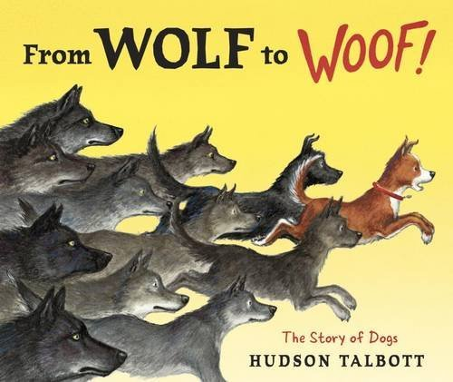
How did dog become man’s best friend? Dogs come in such a variety of shapes, sizes, and breeds, that it is hard to believe that they all have a common ancestor--the wolf! The author takes readers on a fascinating journey through history to see how wolves’ relationships with humans sparked their development into the dogs we know and love today.
670L

Slide 14
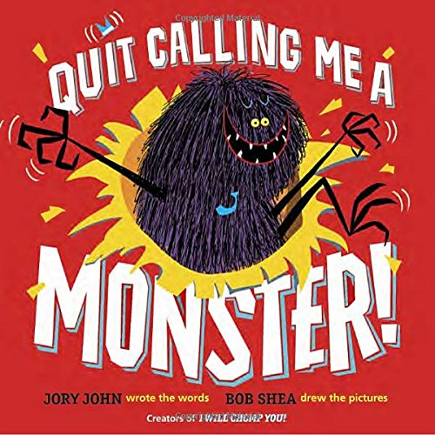
Floyd Peterson is so much more than shaggy purple fur and pointy monster teeth. . .why can't people just see him for him? The authors have created a knee-slapping, read-it-again story that will start a valuable discussion about how we treat others and how it feels to be seen as "different."
Video Reading
Video Reading
Book Trailer
Lexile not available

Slide 15

It's the day before the big parade. Alta can only think about one thing: Wilma Rudolph, three-time Olympic gold medalist. She'll be riding on a float tomorrow. See, Alta is the quickest kid in Clarksville, Tennessee, just like Wilma once was. It doesn't matter that Alta's shoes have holes because Wilma came from hard times, too. But what happens when a new girl with shiny new shoes comes along and challenges Alta to a race? Will she still be the quickest kid? The Quickest Kid in Clarksville is a timeless story of dreams, determination, and the power of friendship.
Video Reading
Video Reading
490L

Slide 16

It's the first day of school at Frederick Douglass Elementary and everyone's just a little bit nervous, especially the school itself. What will the children do once they come? Will they like the school? Will they be nice to him? The school has a rough start, but as the day goes on, he soon recovers when he sees that he's not the only one going through first-day jitters.
Lesson Plan
Video Reading
Video Reading
580L

Slide 17
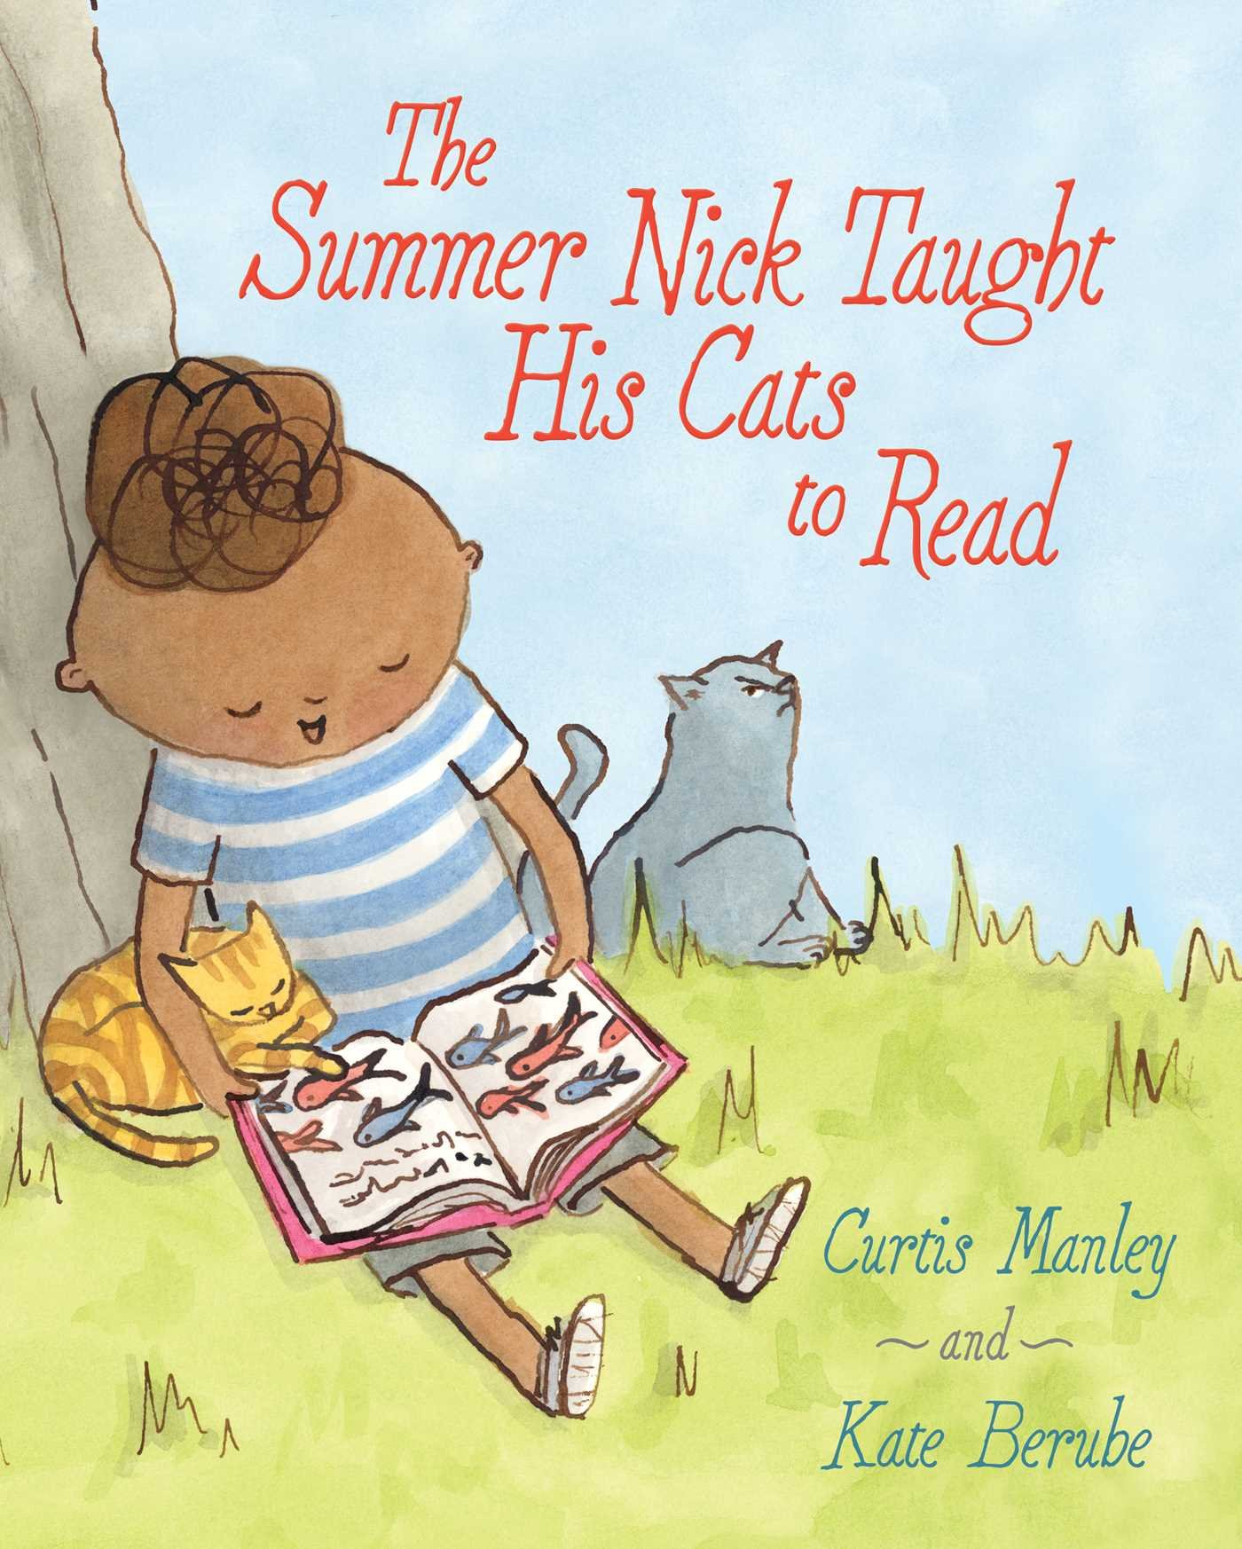
Nick loves to read books—and he loves to play with his cats, Verne and Stevenson. So naturally Nick decides it’s a great idea to teach his cats to read. But Verne and Stevenson don’t appreciate when Nick wakes them up with a flashcard that says NAP. Nick finally piques Verne’s interest with words like MOUSE and FISH. But not Stevenson’s. While Nick and Verne go to the library, Stevenson hides under the porch. Will Nick ever find a way to share his love of reading with his feline friends?
Lesson Plan
Video Trailer
Video Reading
560L

Slide 18

Thunder Boy Jr. is named after his dad, but he wants a name that's all his own. Just because people call his dad Big Thunder doesn't mean he wants to be Little Thunder. He wants a name that celebrates something cool he's done, like Touch the Clouds, Not Afraid of Ten Thousand Teeth, or Full of Wonder. But just when Thunder Boy Jr. thinks all hope is lost, he and his dad pick the perfect name...a name that is sure to light up the sky.
Lesson Plan
Lesson Plan
Lesson Plan
Video Trailer
Author Interview
Video Reading
Video Reading
420L

Slide 19

A girl yearns for a puppy. After much anticipation, her birthday present doesn't turn out to be what she expected. With dreams dashed, she eyes her tortoise warily. Assessing the abilities of her "new lump of a pet," the feisty child discovers that he's not good at fetch, won't "beg for baloney," and doesn't "get excited when you come through the door." The pair do eventually bond over toenail-painting parties and skateboard-enabled walks. When her tortoise goes missing, the girl realizes how much she loves that "rascally guy with the waggly tail."
ELL Lesson Plan
Video Reading
Video Reading
AD610L

Slide 20

You know the Super Soaker. It’s one of top twenty toys of all time. And it was invented entirely by accident. Trying to create a new cooling system for refrigerators and air conditioners, impressive inventor Lonnie Johnson instead created the mechanics for the iconic toy. A love for rockets, robots, inventions, and a mind for creativity began early in Lonnie Johnson’s life. Growing up in a house full of brothers and sisters, persistence and a passion for problem solving became the cornerstone for a career as an engineer and his work with NASA. But it is his invention of the Super Soaker water gun that has made his most memorable splash with kids and adults.
Lesson Plan
Lesson Plan
Lesson Plan
Video Trailer
Author Discusses Book
Video Reading
Lonnie Johnson Speaking
820L

Slide 21

Meet Homer, a dog who heads to camp to live like a wolf!
Homer is a dog . . . but he also secretly fancies himself part wolf. So when an invitation to attend WOLF CAMP (“Where every dog can live as a wolf for a week”) falls out of his kibble bag one morning, he’s determined to go. After his people finally agree, Homer boards the bus bound for Wolf Camp, along with fellow campers Trixie and Rex. They’re greeted on the other end by wolf counselors Fang and Grrr (“they seem nice”), and what follows is an array of wolf activities, including learning to howl, mark, and hunt. Of course, Homer’s a little homesick at times, and the food isn’t very good, but that just makes heading home all the sweeter.
Video Reading
AD510L

Slide 22
2017-2018 SC Picture Book Committee
Amelia Eakin, Jan Faile, Beth Beale, James Bryan, Mary Catoe, Mary Anne Catoe, Susan Easter, Laura Griner, Sheila Keaise, Amy Marshall, Brooke Matthews, Jayne Pinson, Cathy Poole, Helen Prince, Carol Smith, Brenda Stephens, Tracy Turner, Eli E., Madison M.,
London, Erin T.
Pictures Courtesy of
Follett Titlewave
PowerPoint Created by James Bryan

