Slide 1

SC Young Adult Book Award
2018-2019 Nominees
Book summaries and images courtesy of: NoveList Plus database in DISCUS
QR codes provide links to audio booktalks

Slide 2

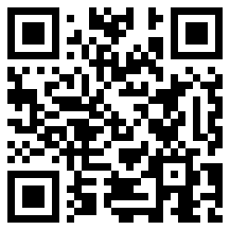
Air by Ryan Gattis
Follows a young man as he enters the strange and exciting world of high octane sports in the inner city of Baltimore.

Slide 3

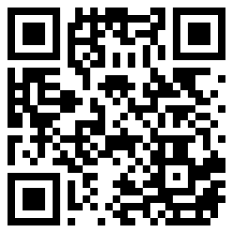
All We Have Left by Wendy Mills
In interweaving stories of sixteen-year-olds, modern-day Jesse tries to cope with the ramifications of her brother's death on 9/11, while in 2001, Alia, a Muslim, gets trapped in one of the Twin Towers and meets a boy who changes everything for her as flames rage around them.

Slide 4

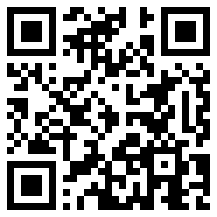
Blood, Bullets, and Bones by Bridget Heos
A history of modern forensic science from the first test for arsenic poisoning in the 1700s to criminal profiling, fingerprinting, blood splatter analysis, DNA evidence, and all the milestones in between.

Slide 5
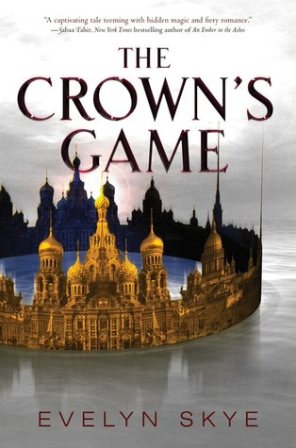
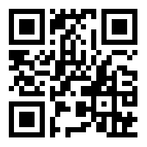
The Crown’s Game by Evelyn Skye
The tsar of Russia sets up a duel between the country's only two enchanters where the winner becomes the tsar's most respected adviser and the loser is executed.

Slide 6

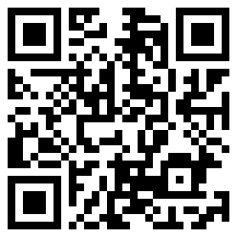
The Girl in the Blue Coat by Monica Hesse
In 1943 Nazi-occupied Amsterdam, teenage Hanneke--a 'finder' of black market goods--is tasked with finding a Jewish girl a customer had been hiding, who has seemingly vanished into thin air, and is pulled into a web of resistance activities and secrets as she attempts to solve the mystery and save the missing girl.

Slide 7

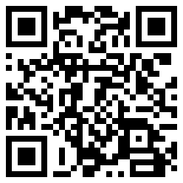
Holding up the Universe by Jennifer Niven
A boy with face blindness and a girl who struggles with weight fall in love.

Slide 8

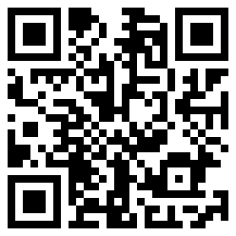
If I Was Your Girl by Meredith Russo
Amanda Hardy only wants to fit in at her new school, but she is keeping a big secret, so when she falls for Grant, guarded Amanda finds herself yearning to share with him everything about herself, including her previous life as Andrew.

Slide 9
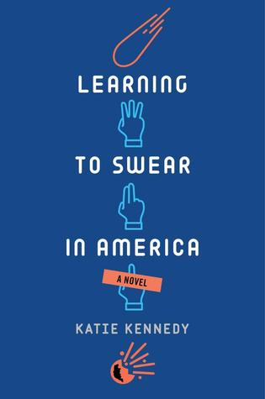
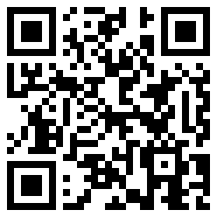
Learning to Swear in America by Katie Kennedy
Brought over from Russia to help NASA prevent an asteroid from colliding with Earth, seventeen-year-old physics genius Yuri feels awkward and alone until he meets free-spirited Dovie.

Slide 10

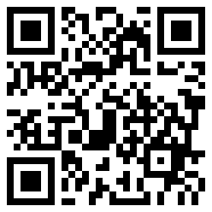
The Radius of Us by Marie Marquardt
Told in alternating voices, follows the growing relationship of two teenaged victims of violence who are struggling to overcome trauma and help each other cope.

Slide 11
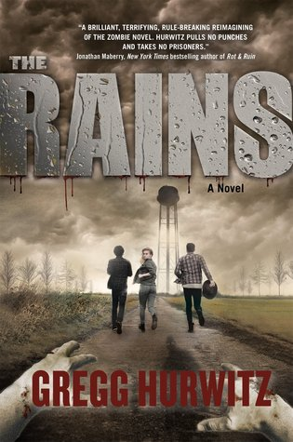
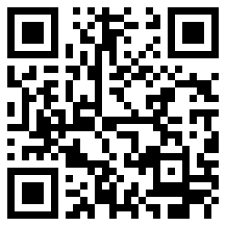
The Rains by Gregg Hurwitz
When the adults in Creek's Cause turn into ferocious, inhuman beings, Chance Rain and his older brother, Patrick, take refuge with other kids at the school, where they work to find the source of the plague.

Slide 12

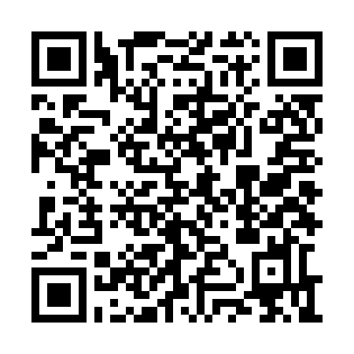
Sachiko: A Nagasaki bomb survivor’s story by Caren Stelson
Tells the story of the atomic bombing of Nagasaki through the eyes of Sachiko Yasui, who was six when the devastation was wrought, describing her experiences in the aftermath of the attack as well as her long journey to find peace.

Slide 13

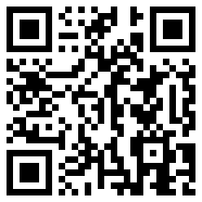
The Safest Lies by Megan Miranda
When Kelsey's agoraphobic mother disappears after years of claiming the kidnappers she escaped from were coming back for her, Kelsey quickly discovers that her mother isn't who she thought she was -- and she's not the abductor's only target.

Slide 14
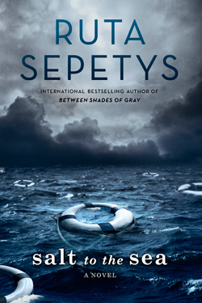
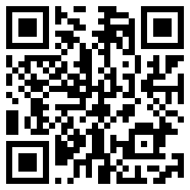
Salt to the Sea by Ruta Sepetys
Titanic. Lusitania. Wilhelm Gustloff. All major maritime disasters, yet the last is virtually unknown. Ruta Sepetys changes that in her gripping historical novel. Told in short snippets, Salt to the Sea rotates among four narrators attempting to escape various tragedies in 1945 Europe.

Slide 15

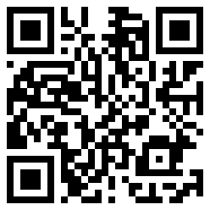
Scythe by Neal Shusterman
In a world where disease has been eliminated, the only way to die is to be randomly killed ('gleaned') by professional reapers ('scythes'). Two teens must compete with each other to become a scythe--a position neither of them wants. The one who becomes a scythe must kill the one who doesn't.

Slide 16
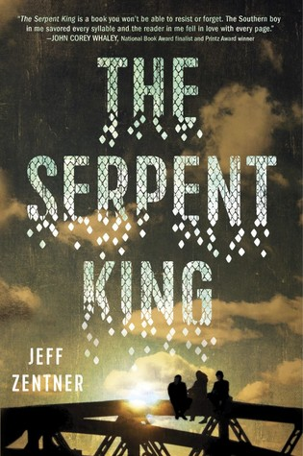
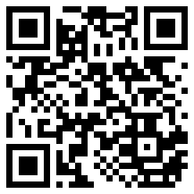
The Serpent King by Jeff Zentner
The son of a Pentecostal preacher faces his personal demons as he and his two outcast friends try to make it through their senior year of high school in rural Forrestville, Tennessee without letting the small-town culture destroy their creative spirits and sense of self.

Slide 17
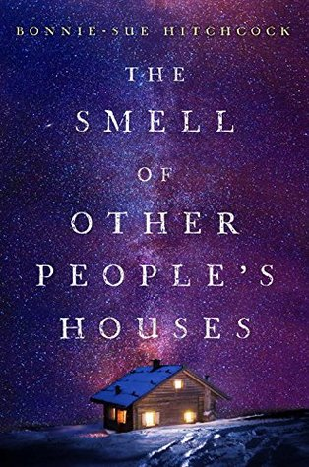
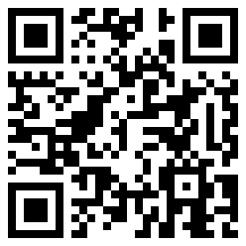
The Smell of Other People’s Houses by Bonnie-Sue Hitchcock
Growing up in Alaska in the 1970s isn't like growing up anywhere else: Don't think life is going to be easy. Know your place. And never talk about yourself. Four vivid voices tell intertwining stories of hardship, tragedy, wild luck, and salvation.

Slide 18
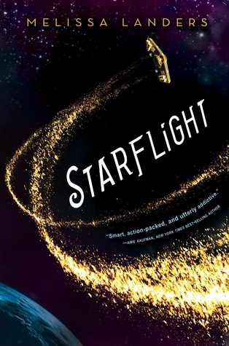
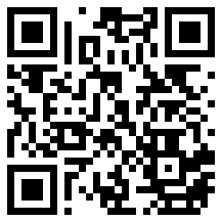
Starflight by Melissa Landers
Desperate to relocate to an off-world place where nobody cares about her humble working status or her criminal past, Solara Brooks indentures herself to a rich bully who pretends to be her servant on a starship full of eccentric crewmates after he is framed for conspiracy on Earth.

Slide 19

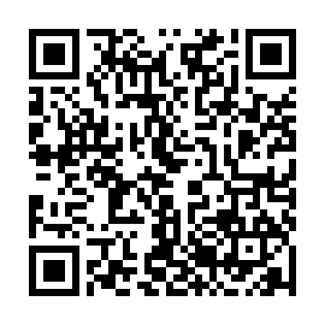
The Sun is also a Star by Nicola Yoon
Natasha, whose family is hours away from being deported, and Daniel, a first generation Korean American who strives to live up to his parents' expectations, unexpectedly fall in love and must determine which path they will choose in order to be together.

Slide 20

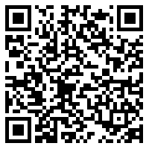
Tell Me Three Things by Julie Buxbaum
Sixteen-year old Jessie, still grieving over her mother's death, must move from Chicago to "The Valley," with a new stepfamily but no new friends until an anonymous fellow student emails and offers to help her navigate the school's treacherous social waters.

Slide 21

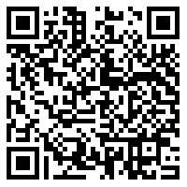
Three Dark Crowns by Kendare Blake
On the island of Fennbirn, triplet sisters who each wield a coveted magic skill and claim an equal right to the throne must fight to the death when they turn sixteen for the title of Queen Crowned.

Slide 22
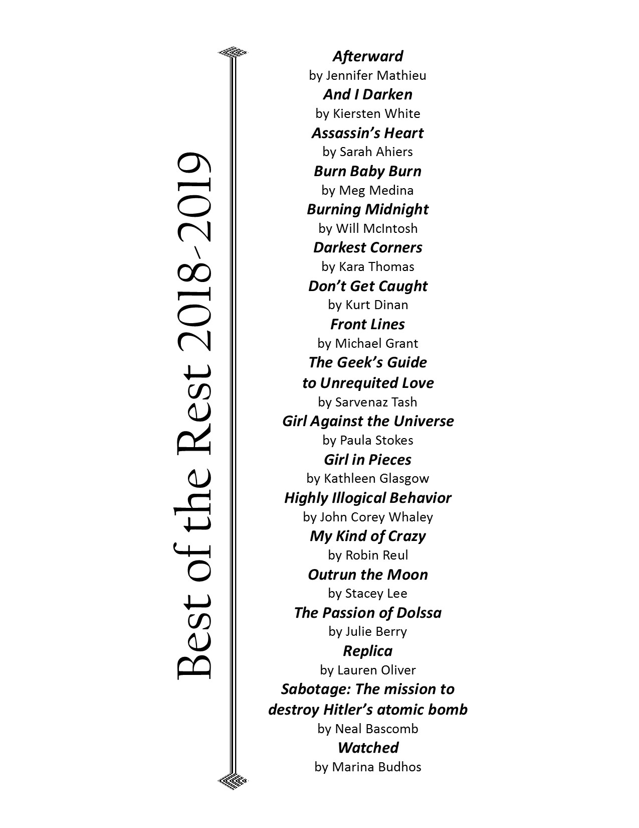
Best of the Rest

Slide 23
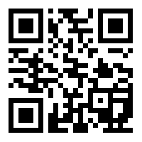
Video booktalks
In addition to the audio booktalks provided by scanning the QR codes on each slide, visit our Flipgrid website to utilize the video booktalks.
We welcome readers to add their own!
https://flipgrid.com/bee93a

Slide 24
Disclaimer
All media specialists should review all titles and add them to their collections only if the titles meet the criteria established by District Board Policy and Library Media Center Policy & Procedure guidelines. We recommend that others interested in purchasing these titles read reviews and scan materials to determine the appropriateness for their intended readers.

Slide 25
SCYABA Committee Members
Laura Bouknight
Lea Brandt
Alison Carpenter
Carolyn Carpenter
Jennifer Gibson
Michelle Greene
Jamie Gregory, Chair
Susan Henley
Tammy McCarn
Jessica Nuckolls
Rose Prince
Donna Roberts, Vice Chair
Karen Rogers
Lori Rogers
Keith Smith
Lori Willis-Richards

