Slide 1


2020-21 Children’s Book Award Nominees
All media specialists should review all titles and add them to their
collections only if the titles meet the criteria established by District
Board Policy and Library Media Center Policy & Procedure
guidelines. We recommend that others interested in purchasing these
titles read reviews and scan materials to determine the
appropriateness for their intended readers.

Slide 2

In Pakistan, Amal holds onto her dream of being a teacher even after becoming an indentured servant to pay off her family's debt to the wealthy and corrupt Khan family.

Slide 3

When Arlo Finch moves to Pine Mountain, Colorado, and joins the Rangers, he learns how to harness the wild magic seeping in from the mysterious Long Woods--a parallel realm of wonder and danger.

Slide 4

Raised by her aunt until she is six, Betty, who will later marry Malcolm X, joins her mother and stepfamily in 1940s Detroit, where she learns about the civil rights movement.

Slide 5

Piano-prodigy Isabella, eleven, whose black father and white mother struggle to share custody, never feels whole, especially as racial tensions affect her school, her parents' both become engaged, and she and her stepbrother are stopped by police.

Slide 6

Since her father's death, Cat has taken care of her brother, Chicken, for their hardworking mother but while spending time with grandparents they never knew, Cat has the chance to be a child again.

Slide 7
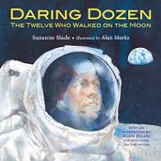
This book describes the experiences of the twelve astronauts who walked on the Moon, showing how the Apollo moon missions built upon one another.

Slide 8

When his family moves to tiny Petersville, eleven-year-old Tris stops focusing on his perfect sister, Jeanine, by using his cooking expertise to revive a town tradition of chocolate cream doughnuts.

Slide 9
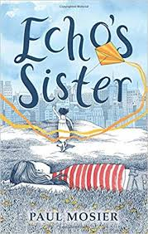
Eleven-year-old Echo finds the courage to help her younger sister fight cancer, and, in the process, finds the love and support of an entire community.

Slide 10
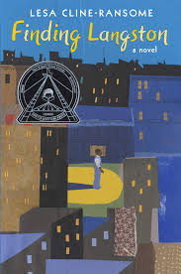
Discovering a book of Langston Hughes' poetry in the library helps Langston cope with the loss of his mother, relocating from Alabama to Chicago as part of the Great Migration, and being bullied.

Slide 11
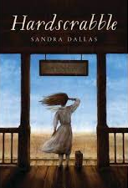
Twelve-year-old Belle Martin and her family move to Mingo, Colorado, in 1910 when the U.S. government offers 320 acres of land free to homesteaders.

Slide 12
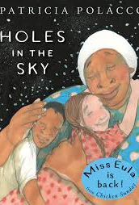
Soon after her beloved grandmother's death, Trisha's family moves to a diverse California neighborhood where she meets Stewart and his grandmother, Miss Eula, who brings people together to help a grieving neighbor.

Slide 13
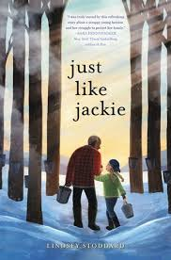
For as long as Robinson Hart can remember, it’s just been her and Grandpa. He taught her about cars, baseball, and everything else worth knowing. But Grandpa’s memory has been getting bad—so bad that he sometimes can’t even remember Robbie’s name. She’s sure that she’s making things worse by getting in trouble at school, but she can’t resist using her fists when bullies like Alex Carter make fun of her for not having a mom.

Slide 14
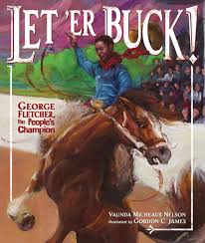
In 1911, three men were in the final round of the famed Pendleton Round-Up. One was white, one was Indian, and one was black. When the judges declared the white man the winner, the audience was outraged. They named black cowboy George Fletcher the "people's champion" and took up a collection, ultimately giving Fletcher far more than the value of the prize that went to the official winner. Award-winning author Vaunda Micheaux Nelson tells the story of Fletcher's unlikely triumph with a western flair that will delight kids—and adults—who love true stories, unlikely heroes, and cowboy tales.

Slide 15

A superstitious 12-year-old living above her family's diner searches for signs to guide her life before taking in a runaway whom she protects in the hope that the girl will safeguard her family from tragedy.

Slide 16

Aspiring knight Max teams up with a band of brave adventurers, the Midknights, on a madcap quest to save a kidnapped relative from a cruel king who is driving all the happiness out of the realm of Byjovia.

Slide 17

When his father brings home an ailing, newborn donkey, Louie names the animal Winslow and takes care of him, but everyone, including Louie's quirky friend Nora, thinks Winslow is not going to survive.

Slide 18
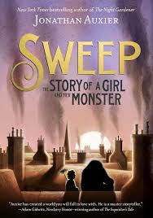
In nineteenth-century England, after her father's disappearance Nan Sparrow, ten, works as a "climbing boy," aiding chimney sweeps, but when her most treasured possessions end up in a fireplace, she unwittingly creates a golem.

Slide 19
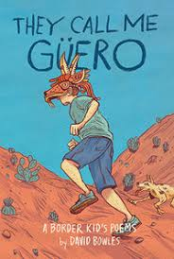
Twelve-year-old Guero, a red-headed, freckled Mexican American border kid, discovers the joy of writing poetry, thanks to his seventh grade English teacher.

Slide 20

Gabriel, twelve, gains new perspective when he becomes friends with Meriwether, a Black World War II hero who has recently returned to the unwelcoming Jim Crow South.

Slide 21
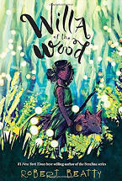
In the late 1800s, a twelve-year-old night spirit living in the Great Smoky Mountains despairs as homesteaders destroy her forest habitat, until a chance encounter with a "day-folk" man changes everything she thought she knew about her people--and their greatest enemy.

Slide 22
Summaries found at NoveList K-8 Plus at www.scdiscus.org.

