Slide 1
2020-2021South Carolina Picture Book Award Nominees
All media specialists should review all titles and add them to their
collections only if the titles meet the criteria established by District
Board Policy and Library Media Center Policy & Procedure
guidelines. We recommend that others interested in purchasing these
titles read reviews and scan materials to determine the
appropriateness for their intended readers.

Slide 2
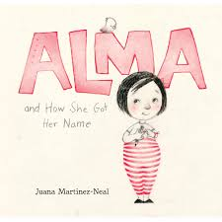
Alma and How She Got Her Name by Juana Martinez-Neal
What’s in a name: For one little girl, her very long name tells the vibrant story of where she came from and who she may one day be. How did Alma Sofia Esperanza Jose Pura Candela end up with such a long name? As daddy tells the story of her many names, Alma can almost feel herself growing into them!

Slide 3
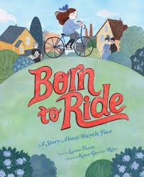
Born to Ride: A Story About Bicycle Face by Larissa Theule
Louise Belinda Bellflower lives in Rochester, New York, in 1896. She spends her days playing with her brother, Joe. But Joe gets to ride a bicycle, and Louise Belinda doesn’t. In fact, Joe issues a solemn warning: If girls ride bikes, their faces will get so scrunched up, eyes bulging from the effort of balancing, that they’ll get stuck that way FOREVER! Louise Belinda strikes out to discover the truth about this so-called “bicycle face.” Set against the backdrop of the women’s suffrage movement, Born to Ride is the story of one girl’s courageous quest to prove that she can do everything the boys can do, while capturing the universal freedom and accomplishment children experience when riding a bike.

Slide 4
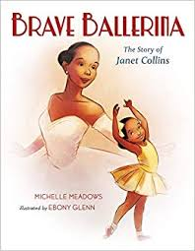
Brave Ballerina: The Story of Janet Collins by Michelle Meadows
This biography describes the life of Janet Collins. Janet Collins was the first African American prima ballerina in the Metropolitan Opera House. She danced in the 1930s and 1940s. The story is told in rhyming couplets, with only a few lines of text on each page. The illustrations start with Janet as a little girl and finish with her taking her bow from the stage of the Opera House.

Slide 5
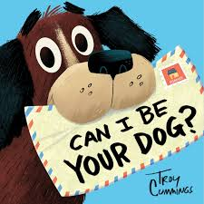
Can I Be Your Dog? by Troy Cummings
Arfy, an optimistic mutt who sleeps in a cardboard box in the alley, writes a series of amusing letters aimed at finding himself a new home. First, he sends notes to the family in a cheerful-looking house and to the butcher. He brags to the fire department that he knows his way around a fire hydrant. He offers to guard the junkyard. He even tries a smelly, tumbledown house. After a series of rejections, he receives an unexpected offer from the mail carrier who delivered his letters. Will he be her friend through “snow, rain, heat, or gloom of night?” Yes.

Slide 6
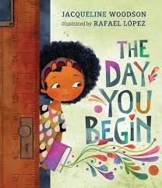
The Day You Begin by Jacqueline Woodson
James and his grandpa are best friends and share the best memories, which show up in the form of balloons. One by one, grandpa’s balloons begin to float away as his memory fades. Grandpa eventually loses all his balloons, even the ones that are the most important to James. James realizes he has to be the balloon carrier for the both of them and helps bring his grandpa back with the help of some balloons.

Slide 7
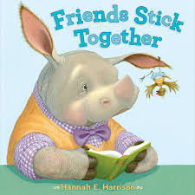
Friends Stick Together by Hannah E. Harrison
Rupert is a rhinoceros of refined sensibilities. Levi, the new tickbird in class, is not. He burps the alphabet, tells corny jokes, and does really embarrassing air guitar solos. Worse, he lands right on Rupert and is determined to be Rupert's symbiotic best pal! Rupert wants him gone. But when Levi finally does bug off, Rupert finds the peace and quiet a little boring. It turns out, Rupert could really use a friend like Levi.

Slide 8
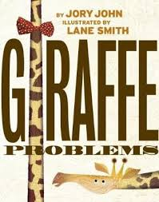
Giraffe Problems by Jory John
Edward the Giraffe feels funny about his neck. He tries to cover it up with ties and scarves. He envies other animals with different necks. He even thinks other animals are staring at his neck. Fortunately a friendly turtle named Cyrus finds Edward and asks the giraffe for help reaching a banana up high. Edward saves the day for Cyrus and the two friends decide that Edward’s neck can have its advantages.

Slide 9
Hidden Figures: The True Story of Four Black Women and the Space Race by Margot Lee Shetterly
This story tells about the contributions of Christine Darden, Dorothy Vaughan, Katherine Johnson, and Mary Jackson to the United States Space program. The refrain “they were good at math. Really good.” is repeated throughout the text. This story pointedly states how women and African Americans were not allowed to do certain things because of their gender or race. Shetterly does a good job of integrating the specific stories of women into broader US and world history of the 1950s. A timeline, glossary and author’s note in the back of the book add meaningful background knowledge to the story.

Slide 10
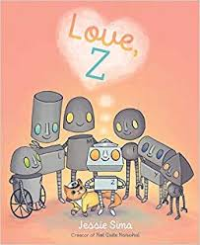
Love, Z by Jessie Sima
A little robot named Z finds a message in a bottle signed, "Love, Beatrice" and, unable to learn what love is from other robots, sets out on a quest to find the answer.

Slide 11
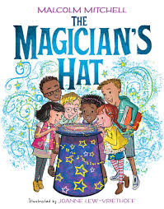
The Magician’s Hat by Malcolm Mitchell
This is not your typical afternoon at the library -- a magician invites kids to reach into his hat to pull out whatever they find when they dig down deep. Soon -- poof! -- each child comes away with something better than they could've imagined -- a book that helps them become whatever they want to be, and makes their dreams come true through pages and words, and the adventures that follow. But each child can't help but wonder, What's really making the magic happen?

Slide 12
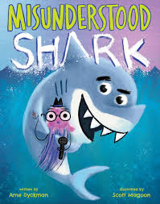
Misunderstood Shark by Ame Dyckman
Shark interrupts the filming of Underwater World With Bob, scattering the other creatures (and the audience), but he claims it is all a terrible misunderstanding--that he would never think of eating the fish, the squid, the audience . . . or Bob.

Slide 13
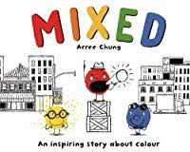
Mixed: A Colorful Story by Arree Chung
This story of tolerance and acceptance begins with three colors, Reds, Yellows, and Blues. They all live happily together until a Red says “Reds are the best!” and starts a color dispute about which is best. The colors decide to separate to different parts of the city until, one day, a Yellow and a Blue get together and create and a never-before-seen color-- Green! What ensues is a uniting of different colors to make new ones, creating colorful families and new feeling of harmony.

Slide 14
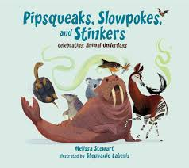
Pipsqueaks, Slowpokes and Stinkers: Celebrating Animal Underdogs by Melissa Stewart
A lighthearted look at the surprising traits that help some animals survive - including behaviors of a variety of animals, such as shrews, armadillos, naked mole rats, and okapi.
Written with a lively, playful voice, Pipsqueaks, Slowpokes, and Stinkers introduces young readers to a variety of ?animal underdogs? and explains how characteristics that might seem like weaknesses are critical for finding food and staying safe in an eat-or-be-eaten world.

Slide 15
Planting Stories: The Life of Librarian and Storyteller Pura Belpré by Denise Aldamuy Anika
Pura Belpre moved to New York City from Puerto Rico and found comfort in the library in her neighborhood. She begins to work there and becomes a storyteller, puppeteer, and a bilingual assistant. Her talent brings her stories to life and cements them in library culture for future generations to discover.

Slide 16
Remarkably You by Pat Zietlow Miller
Remarkably You is an inspirational manifesto about all of the things--little or small, loud or quiet--that make us who we are.
With encouraging text by Pat Zietlow Miller and exuberant illustrations by Patrice Barton, readers will delight in all the ways they can be their remarkable selves.

Slide 17
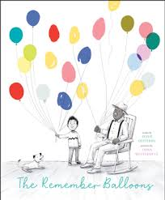
The Remember Balloons by Jessie Oliveros
James and his grandpa are best friends and share the best memories, which show up in the form of balloons. One by one, grandpa’s balloons begin to float away as his memory fades. Grandpa eventually loses all his balloons, even the ones that are the most important to James. James realizes he has to be the balloon carrier for the both of them and helps bring his grandpa back with the help of some balloons.

Slide 18
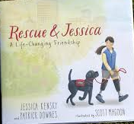
Rescue & Jessica: a Life-Changing Friendship by Jessica Kensky and Patrick Downes
Story about the relationship between a disabled girl and her black lab service dog is based loosely on Kensky’s own experiences as a double amputee. The author’s note mentions how she and husband Downes were injured in the Boston Marathon bombing in 2013, but readers don’t need to know this to be caught up in the story. The book follows two struggles: that of Rescue, a lab in training as a service dog, and of Jessica, a girl hospitalized by an injury, who must learn to cope with prosthetics, a wheelchair, and a whole new world of challenges.

Slide 19
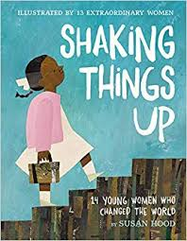
Shaking Things Up by Susan Hood
In this book of poems, you will find Mary Anning, who was just thirteen when she unearthed a prehistoric fossil. You'll meet Ruby Bridges, the brave six year old who helped end segregation in the South. And Maya Lin, who at twenty-one won a competition to create a war memorial, and then had to appear before Congress to defend her right to create.
And those are just a few of the young women included in this book. This poetry collection was written, illustrated, edited, and designed by women and includes an author's note, a timeline, and additional resources.

Slide 20
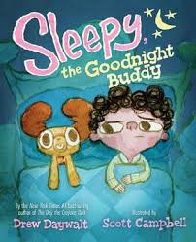
Sleepy, the Goodnight Buddy by Drew Daywalt
Roderick hates going to bed, and he asks for everything he can think of to try and stay up. His parents present him with a goodnight buddy to help him sleep. Bad idea! Sleepy, the Goodnight Buddy keeps Roderick awake with all kinds of distractions from witches in the closet, to brushing his teeth. Roderick grows very frustrated as he wonders if he will ever get to sleep!

Slide 21
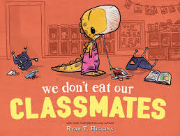
We Don’t Eat Our Classmates by Ryan T. Higgins
The first day of school is coming, and Penelope, an orange T. rex with the air of a squishy stuffed animal, is nervous about making friends. But her lunch of 300 sandwiches is packed, and her backpack, featuring delicious ponies, is ready to go. Sensing a theme? Penelope thinks with her stomach—a trait that gets her into trouble when she discovers that her classroom is populated entirely by tasty, tasty children. Penelope promptly eats them all. She spits them out, but it’s a little hard to make friends after that. Her dad tries to explain why people don’t like being eaten, but it’s not until Penelope makes a lonely attempt to befriend the classroom goldfish that she truly understands.

Slide 22
Credits
Photos: GoodReads.com
Synopsis: 2019-20 SCASL PBA committee, publishers via Follett titlewave

